Slide 1
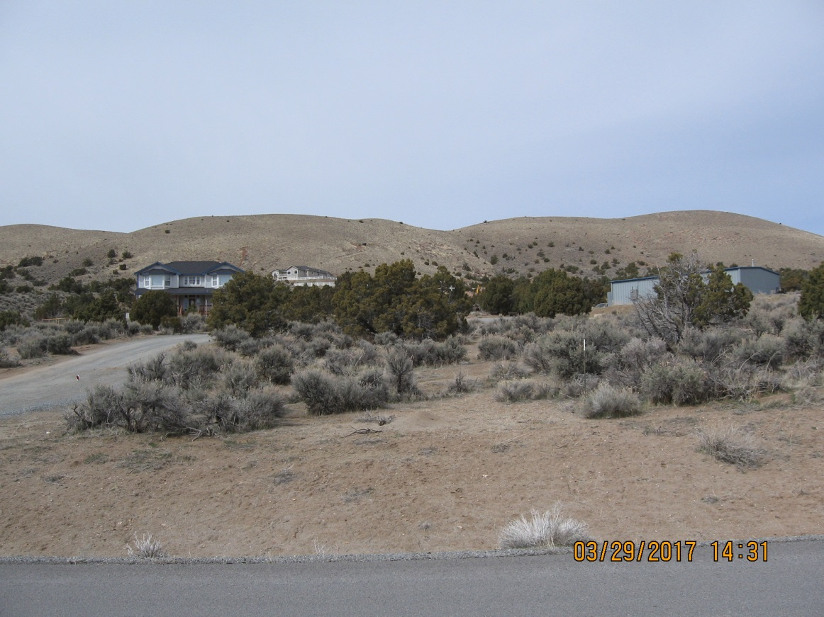
WADMIN18-0001 Christensen
Washoe County Board of Adjustment
April 5, 2018

Slide 2
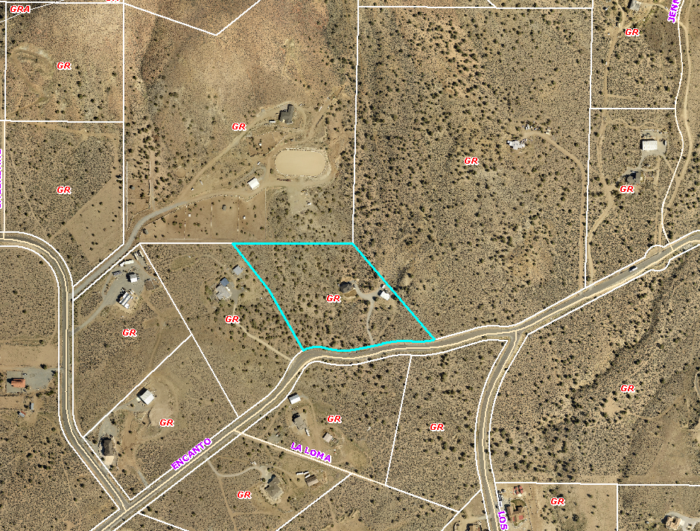
Overview
± 9 acre parcel
General Rural
Single family dwelling
Shop/garage
4 of 5 abutting property owners signed consent forms

Slide 3
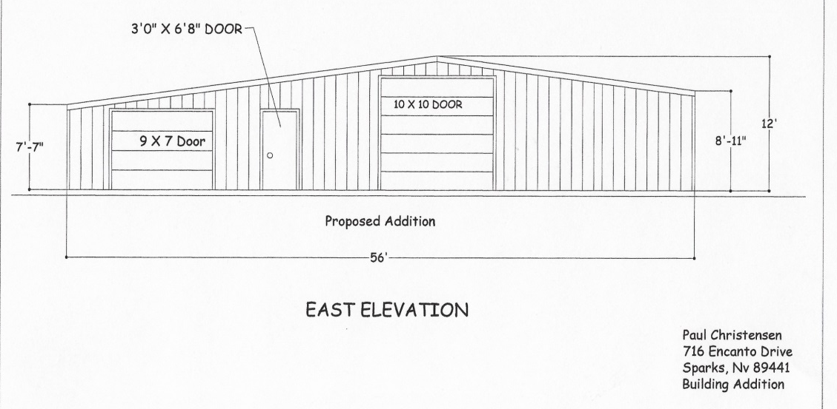
Elevations
Build on to existing garage, making foot print of accessory structure larger than house

Slide 4
Site Plan
One neighbor concerned that structure is to close to property line

Slide 5
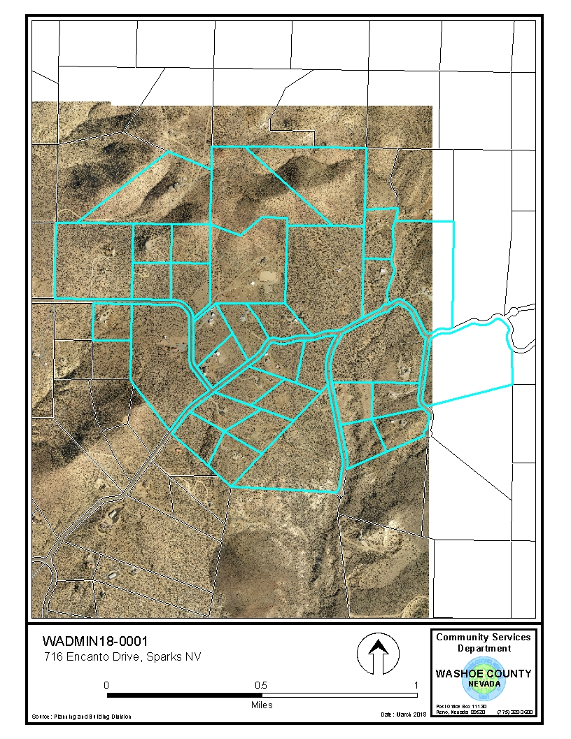
Public Notice & CAB
Spanish Springs CAB
33 property owners within 500 feet

Slide 6
Reviewing Agencies
Washoe County Community Service
Planning and Building Division
Engineering and Capital Projects
Washoe County Health District
Environmental Health Services Division
Regional Transportation District
Truckee Meadows Fire Protection District
Washoe Storey Conservation District

Slide 7
Administrative Permit
1. Consistency
2. Improvements
3. Site Suitability
4. Issuance Not Detrimental

Slide 8
Possible Motion
I move that, after giving reasoned consideration to the information contained in the staff report and information received during the public hearing, the Board of Adjustment approve, with the Conditions of Approval included in Exhibit A to this matter, Administrative Permit Case Number WADMIN18-0001 for Paul and Cynthia Christensen, having made the four required findings in accordance with Washoe County Code Section 110.808.25:

